Slide 1

T5Bayes
This presentation explores the development of a robust text analysis system that combines state-of-the-art summarization and sentiment analysis models to streamline review processing and provide valuable insights.

Slide 2


Our Team: CoBinet
Adarsh Kishor Kashyap
Naman Rao Ghorpade
E22CSEU1137
E22CSEU1133
SUMMARIZER MODEL, MODEL TRAINING
SENTIMENT MODEL,INTEGRATING THE MODELS

Slide 3

Introduction
Review Processing Challenges
Powerful AI Models
Integrated System
Recent advances in natural language processing enable sophisticated text summarization and sentiment analysis.
Combining summarization and sentiment analysis can provide a comprehensive understanding of reviews.
Manual review analysis is time-consuming and prone to bias. Automated solutions are needed.

Slide 4



Problem statement
Review Volume Challenge
Text Summarization
Sentiment Analysis
Businesses struggle with an overwhelming volume of customer reviews that are time-consuming to process manually
State-of-the-art text summarization technology automatically condenses lengthy reviews into key points
Intelligent sentiment analysis converts detailed customer feedback into actionable business insights

Slide 5

Scripts Train and Integrate Models
1
Data Preprocessing
Clean and preprocess review datasets from IMDb and e-commerce sources.
2
Model Training
Train a T5 text summarizer and a Naive Bayes sentiment analyzer on the prepared data.
3
Model Integration
Combine the summarization and sentiment analysis models into a unified system.

Slide 6

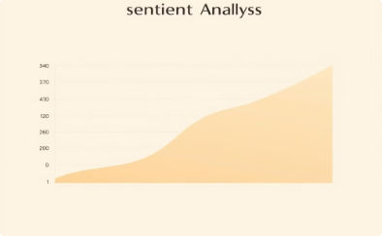
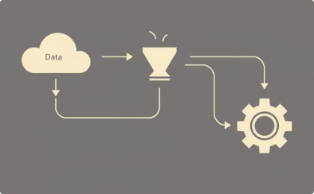
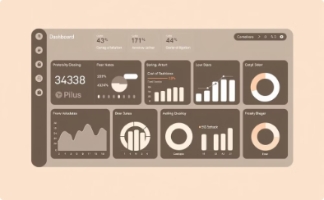
Proposed Solution Approach
Robust Text Summarization
Intelligent Sentiment Analysis
Integrated Processing Pipeline
Streamlined User Experience
Leverage state-of-the-art T5 transformer models to automatically condense lengthy customer reviews into concise summaries.
Apply advanced Naive Bayes classification to determine the overall sentiment of each review with high accuracy.
Combine the summarization and sentiment analysis models into a unified system for efficient review processing.
User-friendly Streamlit application enabling seamless review analysis and business insights.

Slide 7
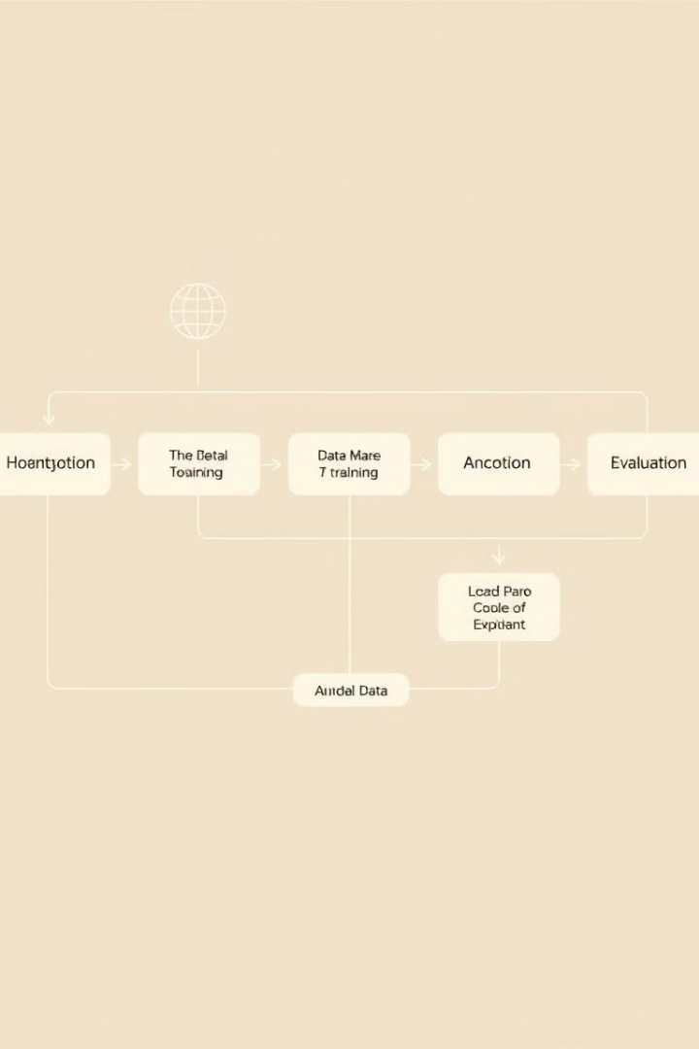



Methodologies
Data Preprocessing
Clean and format review text, handle missing values, and remove noise.
T5 Summarization
Leverage the power of the T5 transformer model to generate concise review summaries.
Naive Bayes Sentiment
Apply the Naive Bayes classifier to predict the sentiment (positive, negative, or neutral) of reviews.

Slide 8
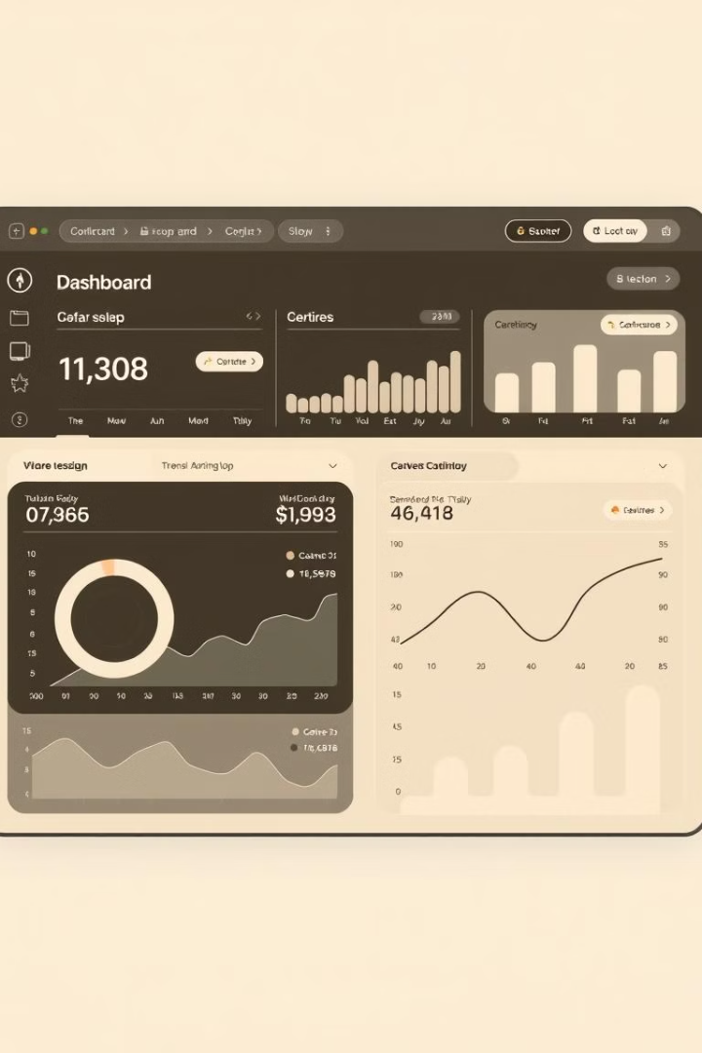
Streamlining Review Processing with Streamlit
Intuitive GUI
Deployment Simplicity
Stream lit allows us to build a user-friendly graphical interface to present our review analysis tools.
Streamlit makes it easy to deploy the review processing system as a web application.

Slide 9

Conclusion
Streamlined Review Processing
Valuable Insights
The system provides businesses with a deeper understanding of customer sentiment and preferences.
The integrated system enables efficient summarization and sentiment analysis of product reviews.
Versatile Application
The models can be applied to various domains beyond product reviews, such as social media and news articles.

